Slide 1
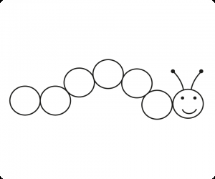
Butterfly Maths
Each caterpillar must be coloured the correct pattern for it to turn into a butterfly. Work out each problem to know how to colour each caterpillar.
Key
6 = yellow, 4 = blue, 2 = red, 10 = green, 5 = pink, 1 = purple, 3 = orange
4 + 1
5 - 3
5 + 5
2 + 2
3 - 2
4 - 1
10 - 5
4 + 6
2 + 4
10 - 4
5 - 3
10 - 8
19 - 9
2 + 8
5 x 2
2 x 2
8 ÷ 2
6 ÷ 3

Slide 2
Butterfly Maths – Answers
Each caterpillar must be coloured the correct pattern for it to turn into a butterfly. Work out each problem to know how to colour each caterpillar.
Key
6 = yellow, 4 = blue, 2 = red, 10 = green, 5 = pink, 1 = purple, 3 = orange
5
pink
2
red
10 green
4 blue
1 purple
3 orange
5
pink
10 green
6 yellow
6 yellow
2
red
2
red
10 green
10 green
10 green
4 blue
4 blue
2
red

